Slide 1


MY
PRESENTATION BOOK Eco-friendly facility
Dr Manoranjan Mohapatra, Consultant-QI & QA (Mgt.), NHM, Odisha

Slide 2


Introduction
A Green hospital is one which enhances patient well being, aids in curative process while utilizing natural resources in an efficient environment friendly manner
Components:
Utilizes sustainable, renewable resources and efficient designs
Uses green building materials and products,
Thinks green during construction and keeps the greening process going
Choose an environment friendly site,
3 R Methods: Recycle, reuses materials, reduces waste,
Produces cleaner air.
Reduce Co2 generation
PAGE 01

Slide 3
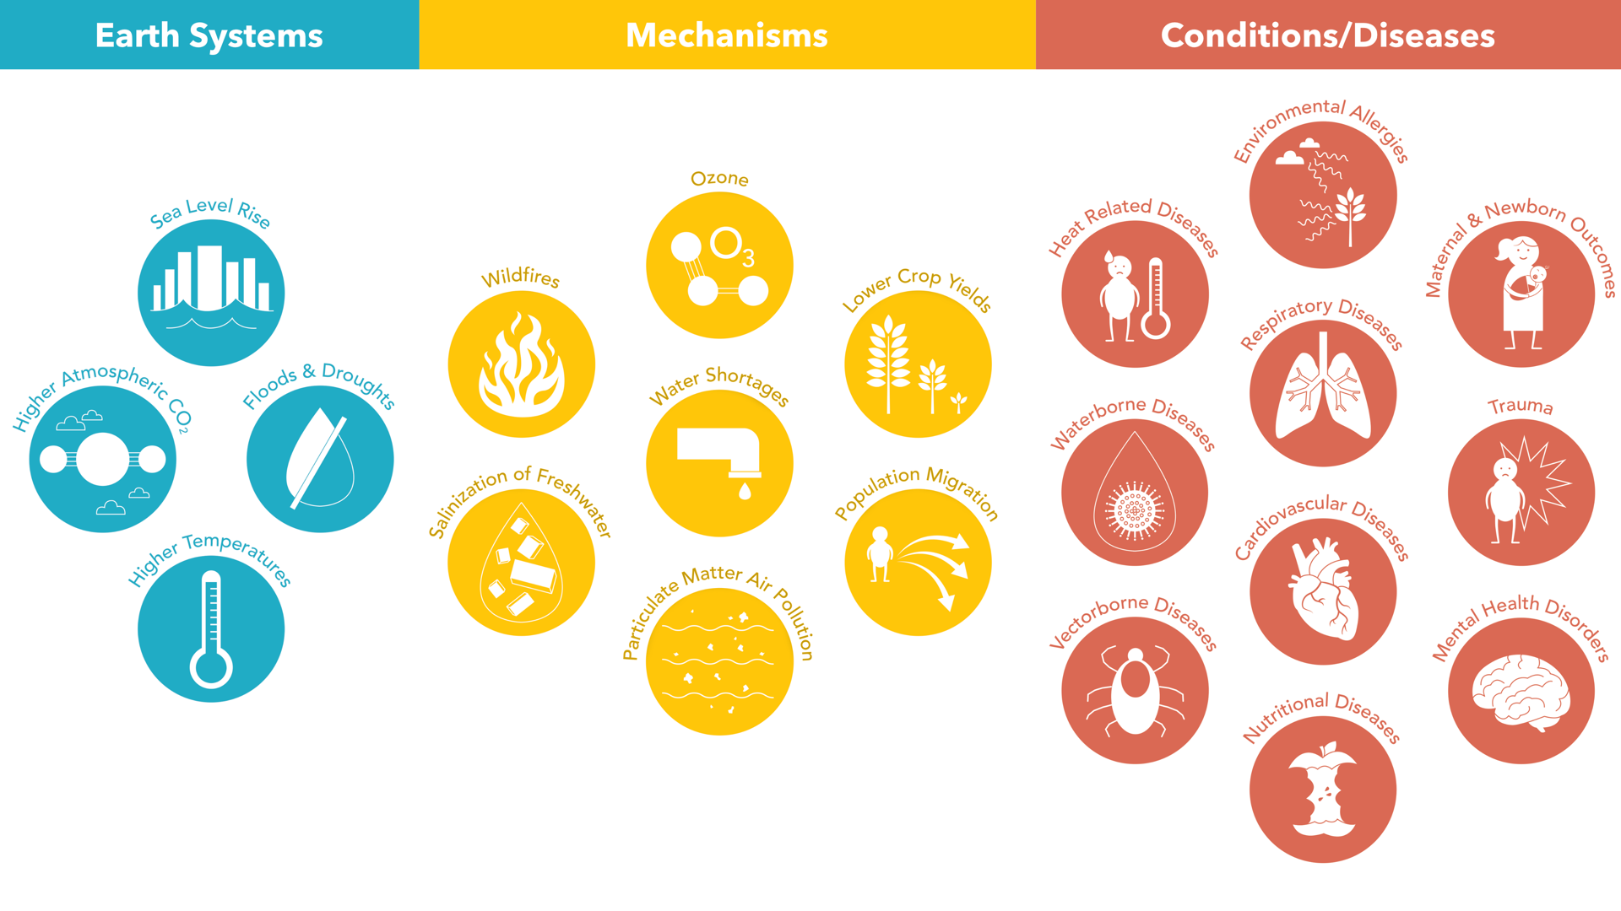
Two sub-categories:
Best
n all States/UTs, the top ranked DH will get best ‘eco-friendly’ award in the District Hospital category.
Best ‘eco-friendly’ CHC/SDH Award: - In all States/UTs, the top ranked CHC/SDH will receive an ‘eco-friendly’ award in CHC/SDH category.
Identifying pathways Climate/Health Framework
PAGE 08
Figure courtesy of Harvard University

Slide 4
Two sub-categories:
Best
in the District Hospital category.
National Programme for Climate Change & Human Health (NPCCHH)
Objectives
National Programme for Climate Change & Human Health(NPCCHH) at a glance:
Ministry of Health and Family Welfare (MoHFW) is the nodal agency and National Centre for Disease Control (NCDC), New Delhi is the nodal technical agency to undertake coordination activities & prepare strategies.
The Ministry of Health and Family Welfare (MoHFW) approved National Programme on Climate Change and Human Health (NPCCHH) under National Health Mission (NHM) in February 2019.
To strengthen health care services against adverse impact of climate change on health
The common Climate Sensitive Diseases (CSDs) are - air pollution related, heat related, water-borne, vector-borne, cardiopulmonary diseases, mental health, food-borne, nutrition related illnesses etc.
Currently the three key areas of focus for NPCCHH include air pollution, heat related illnesses and creation of green and climate resilient healthcare facilities.
PAGE 15
PAGE 16

Slide 5
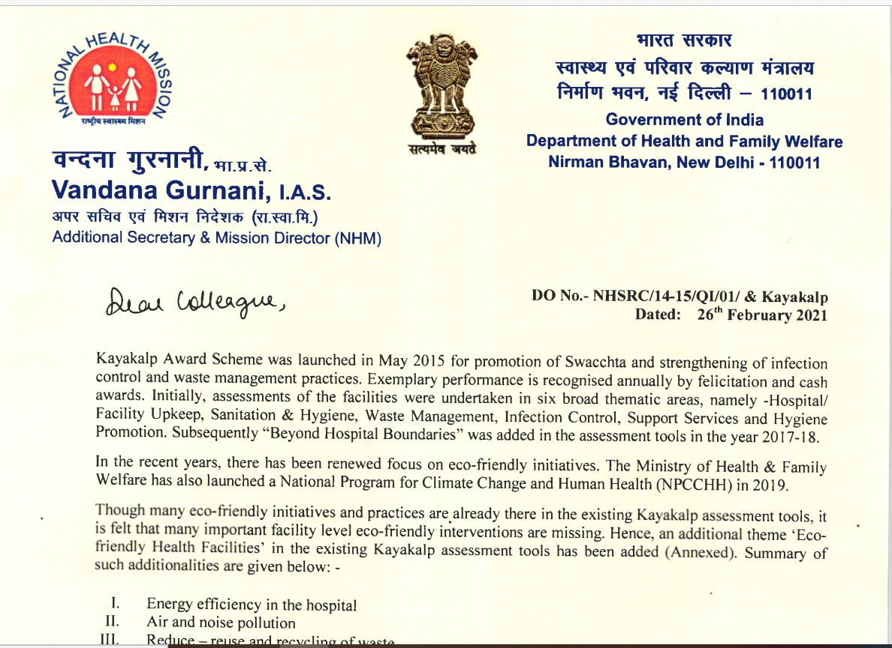
Two sub-categories:
Best
in the District Hospital category.
Need of the new concept: Facility level response-Eco-friendly concept
Approval letter-MoHFW
With a focus on eco-friendly initiatives, the Ministry of Health & Family Welfare has also launched a National Program for Climate Change and Human Health (NPCCHH) in 2019.
Though many eco-friendly initiatives and practices are already there in the existing assessment tools, many important facility level eco-friendly interventions are missing.
Hence, an additional theme ‘Eco-friendly Health Facilities’ has been added in the existing Kayakalp assessment tools.
PAGE 17
PAGE 18

Slide 6
Two sub-categories:
Best
in the District Hospital category.
Few additionalities under existing thematic areas
Cleanliness of ambulances
Usage of Environmentally preferable cleaning product, equipment, etc.
Disposal of PPEs
Inclusion of Typhoid vaccination for kitchen staffs/food handlers
Safe fogging of OT
Inclusion of JAS (Jan Arogya Samiti) under community monitoring & patient participation.
Implementation of Sustainable Procurement Policy
Disposal of waste collected from any infectious disease like COVID-19
Removal of junk materials (implementation of condemnation policy along with condemnation of old ambulances/vehicles)
Landscaping & gardening (Inclusion of both hardscaping and soft-scaping)
Innovative practices for water conservation
Landscaped area is planted with drought tolerant plants (e.g., Cactus, Palm, snake plant, lavender etc.)
Usage of grey water for irrigation and toilet flushing etc.
PAGE 19
PAGE 20

Slide 7
Two sub-categories:
Best
in the District Hospital category.
Additions/modifications under existing thematic areas(From A to G)
Ref. No. | Criteria
A8.5 | Hospital has documented and implemented Condemnation policy along with condemnation of old ambulances/vehicles.
A9.1 | Water supply is adequate in Quantity & Quality
A9.2 | Water supply system is maintained in the hospital and there is a system of periodical inspection for water wastage
A9.3 | Hospital promotes water conservation
A 9.4 | Hospital has a functional rain water harvesting system
A.9.5 | The hospital has innovative practices for water Conservation
Ref. No. | Criteria
A1.1 | No stray animals within the facility premises
A1.3 | Integrated Pest Control Management is implemented in the facility
A2.1 | Facility’s front area is landscaped (Both hardscaping and soft-scaping)
A2.5 | Provision of Herbal Garden
A3.2 | No water logging in open areas and the facility buildings are vector- breeding proof
A3.4 | Open areas are well maintained
A6.5 | Adequate illumination in auxiliary area
PAGE 21
PAGE 22

Slide 8
Two sub-categories:
Best
Hospital category.
Ref. No. | Criteria
B4.5 | Cleanliness of Ambulance
B5 | Cleanliness of Auxiliary Areas (Kitchen, Laundry, Mortuary, Administrative office)
B7.1 | Availability of Detergent Disinfectant solution / Hospital Grade Phenyl for Cleaning purpose Hospital is using environmentally Preferable Cleaning products, materials and equipment
B7.4 | Availability of eco-friendly/bio-degradable Buckets and carts for Mopping
B8.1 | Use of Three bucket system for cleaning
Ref. No. | Criteria
B9.2 | Use of Housekeeping Checklist in Patient Care Areas & ambulance
C1.1 | The Hospital leadership is aware of Biomedical Waste Rules 2016 including key changes as amendments.
C5.5 | Disposal of PPEs (goggles, face-shield, splash proof apron, plastic coverall, hazmat suit, nitrite gloves etc.) are disposed as per procedure given in the BMW rules 2016 and its subsequent amendments including infectious disease like COVID 19
PAGE 23
PAGE 24

Slide 9
Two sub-categories:
Best
District Hospital category.
Ref. No. | Criteria
C6.1 | The Staff is aware of Mercury Spill management
C6.2 | Availability of Mercury Spill Management Kit
C6.4 | Disposal of Disinfectant solution like Glutaraldehyde & Disposal of Lab reagents
C6.5 | Disposal of waste collected from infectious disease like COVID-19
C8.3 | The Facility has treatment facility for managing infectious liquid waste
Ref. No. | Criteria
C9.1 | Availability of foot operated Bins and other bins with liners for segregated collection of waste at point of use
C10.5 | The Health Facility maintains records, as required under the Biomedical Waste Rules 2016 and its subsequent amendments
D8.4 | Immunization of Service Providers
D10.4 | Surface cleaning and safe fogging of OT
E3.5 | Food to patients is distributed through covered trolleys and patients’ utensils are not dented or chipped - off and facility adopted the system of Food Waste Reduction and Composting
PAGE 25
PAGE 26

Slide 10
Two sub-categories:
Best
Hospital category.
Ref. No. | Criteria
F1.1 | Members of RKS /JAS (Jan Arogya Samiti) and Local Governance bodies monitor the cleanliness of the hospital at pre-defined intervals
F1.5 | The health facility has a system to take feed-back from patients and visitors for maintaining the cleanliness of the facility (Manual/Mera Aspatal)
F2.2 | IEC regarding Swachhata Abhiyan is displayed within the facilities’ premises along with relevant IECs pertaining to National Clean Air Programme/water pollution/reuse of water etc.
Ref. No. | Criteria
F3.3 | Roles and responsibility of different staff members have been assigned and communicated The management of the hospital is committed to implement the concept of green healthcare and the hospital management shall follow the Sustainable Procurement Policy (SPP)
F4.4 | Hospital has documented Standard Operating procedures for Cleanliness and Upkeep of Facility and guidelines/SOPs are available to educate and help them towards implementation of go green concept
G1.2 | Implementation of IEC activities related to ' Swachh Bharat Abhiyan' including IEC/BCC activities to promote go green concept
G5.5 | Functional street lights are available along the approach road
PAGE 27
PAGE 28

Slide 11
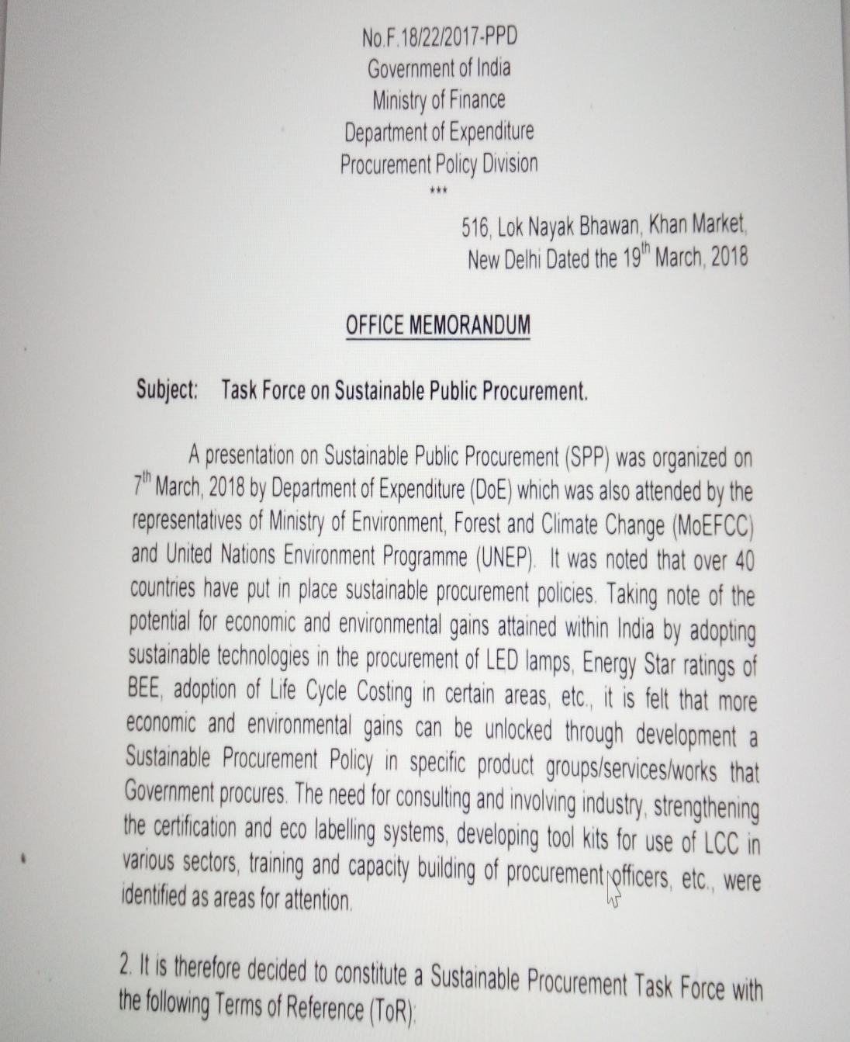
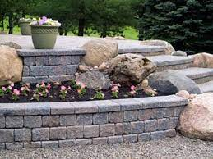

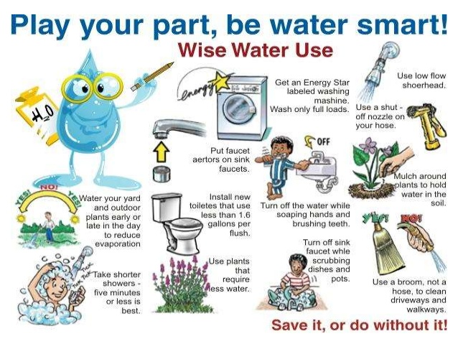

Two sub-categories:
Best
District Hospital category.
Ways of fulfilling….
Sustainable Procurement Policy
Hard scaping
Soft scaping
Water conservation
Drought tolerant plants
PAGE 29
PAGE 30

Slide 12
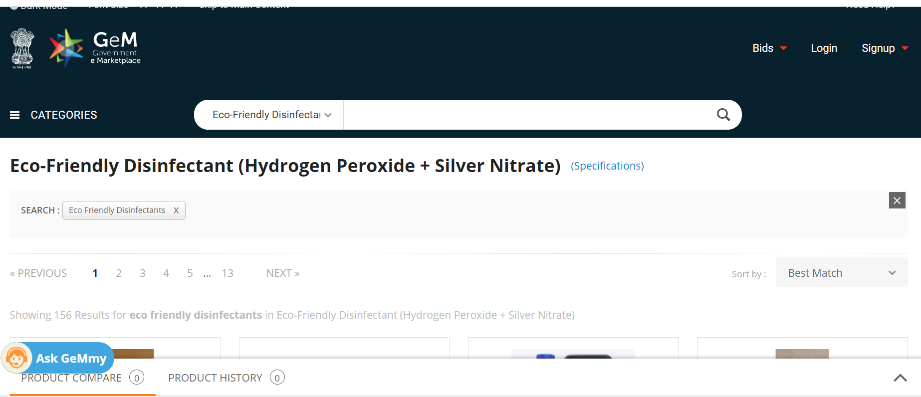
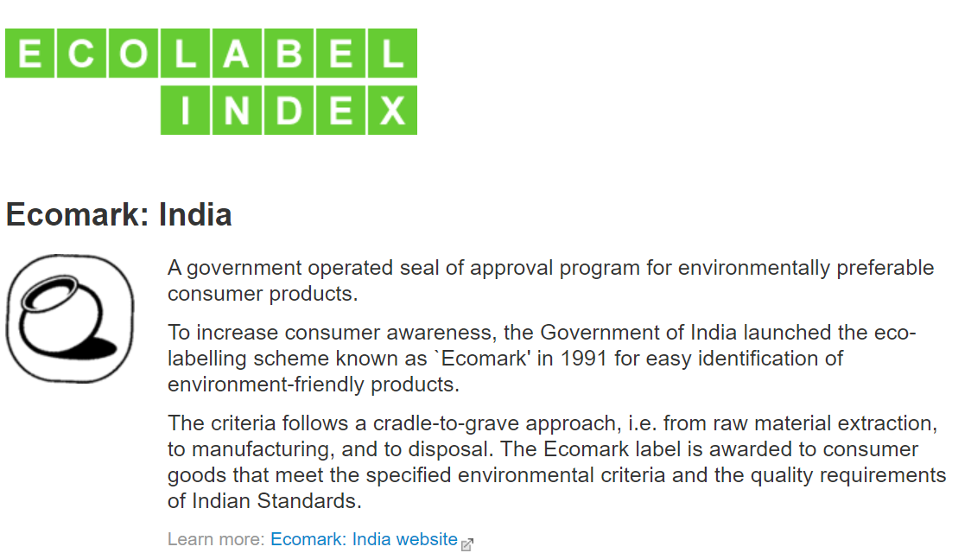
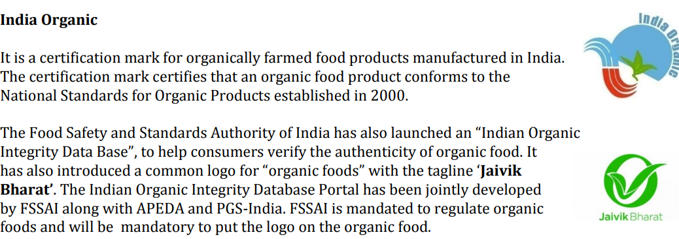

Two sub-categories:
Best
District Hospital category.
GeM Portal.
Eco -friendly logos
PAGE 31
PAGE 32

Slide 13
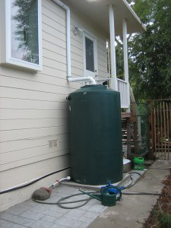
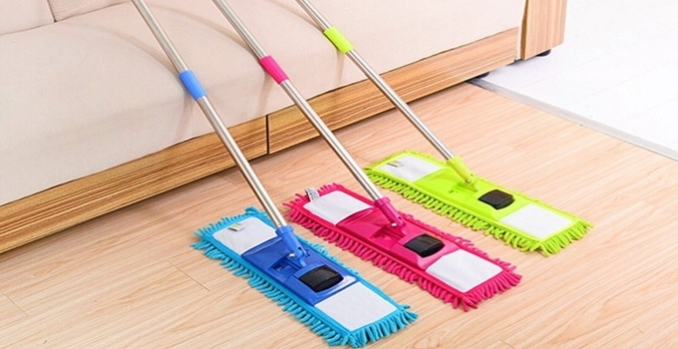
Two sub-categories:
Best
in the District Hospital category.
Water conservation
Strategy for the optimum usage and conservation of water should be developed(landscaping with drought tolerant plants/ use of grey water for gardening)
Healthcare facility shall have a plan for the waste water treatment.
The healthcare facility shall have a plan to train the staff for water savings techniques.
Inclusion under Hospital Budget Plan and approval
Example: Use microfiber mops instead of cotton mops. It is more water-efficient. Mopping with micro fibrotic mops increases cleaning efficiency. This mop can also withstand 300-500 washings as against 55 for cotton mops.
PAGE 33
PAGE 34

Slide 14
Introduction of newly added thematic area: Eco-friendly facility
PAGE 35

Slide 15
Introduction of newly added thematic area: Eco-friendly facility
H1
Energy efficiency
H
H2
Air and noise pollution
H3
Reduce –reuse and recycle of waste
H4
Save earth and environment
H5
Health and wellbeing

Slide 16
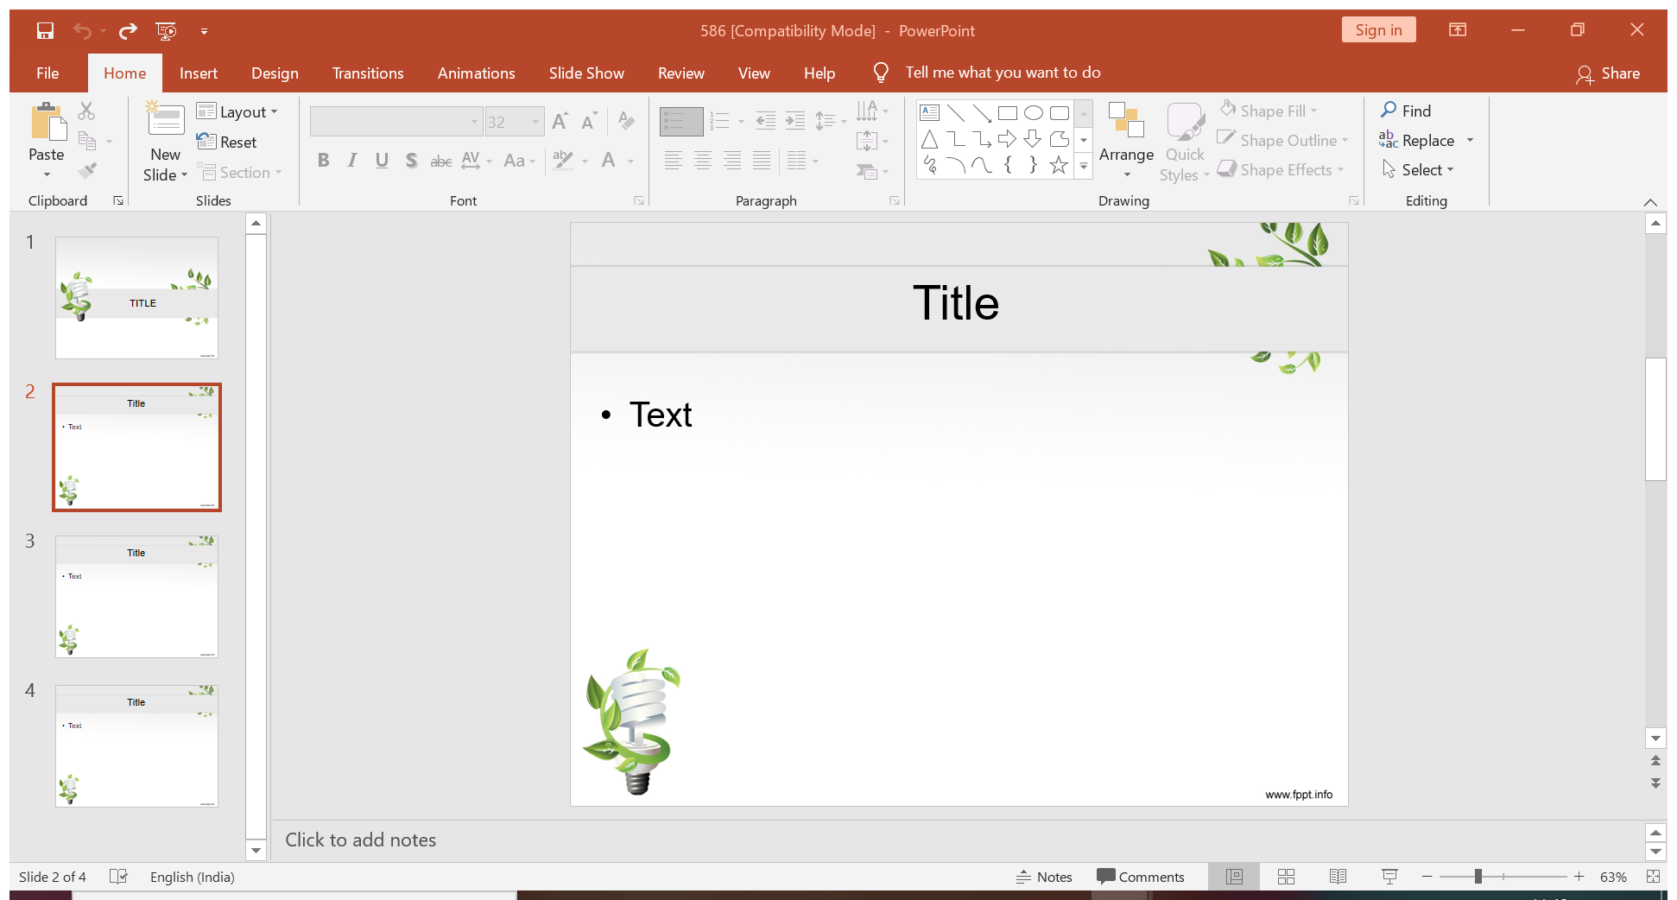
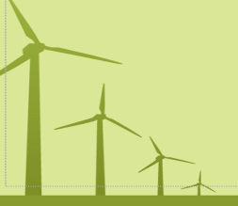
Two sub-categories:
Best
’ award in the District Hospital category.
H1-Energy efficiency
H1.1
H1.4
Energy audit is being conducted in the facility
Facility maximize the usage of natural lighting
H1.2
Facility promotes low-energy lighting
H1.5
On-site renewable energy generation in the facility
H1.3
Lighting control in common area of the hospital
PAGE 37
PAGE 38

Slide 17
Two sub-categories:
Best
District Hospital category.
Implementation strategy
Preliminary Energy Audit Methodology
Preliminary energy audit is a relatively quick exercise to:
Establish energy consumption in the organization
Estimate the scope for saving
Identify the most likely (and the easiest areas for attention
Identify immediate (especially no-/low-cost) improvements/ savings
Set a ‘reference point’
Identify areas for more detailed study/measurement
Preliminary energy audit uses existing, or easily obtained data
Detailed Energy Audit Methodology
A comprehensive audit provides a detailed energy project implementation plan for a facility, since it evaluates all major energy using systems(Pre audit, audit and post audit process)
Energy audit process
The primary objective of Energy Audit is
to determine ways to reduce energy consumption per unit of product output or
to lower operating costs. Energy Audit provides a “ bench-mark” (Reference point) for managing energy in the organization and
also provides the basis for planning a more effective use of energy throughout the organization.
Could be done through:
Preliminary Audit
Detailed Audit
PAGE 39
PAGE 40

Slide 18

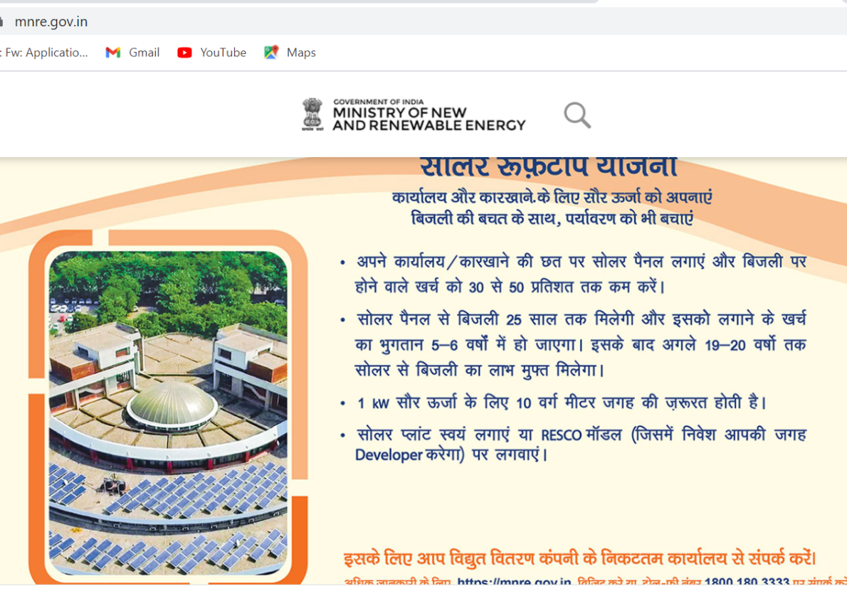
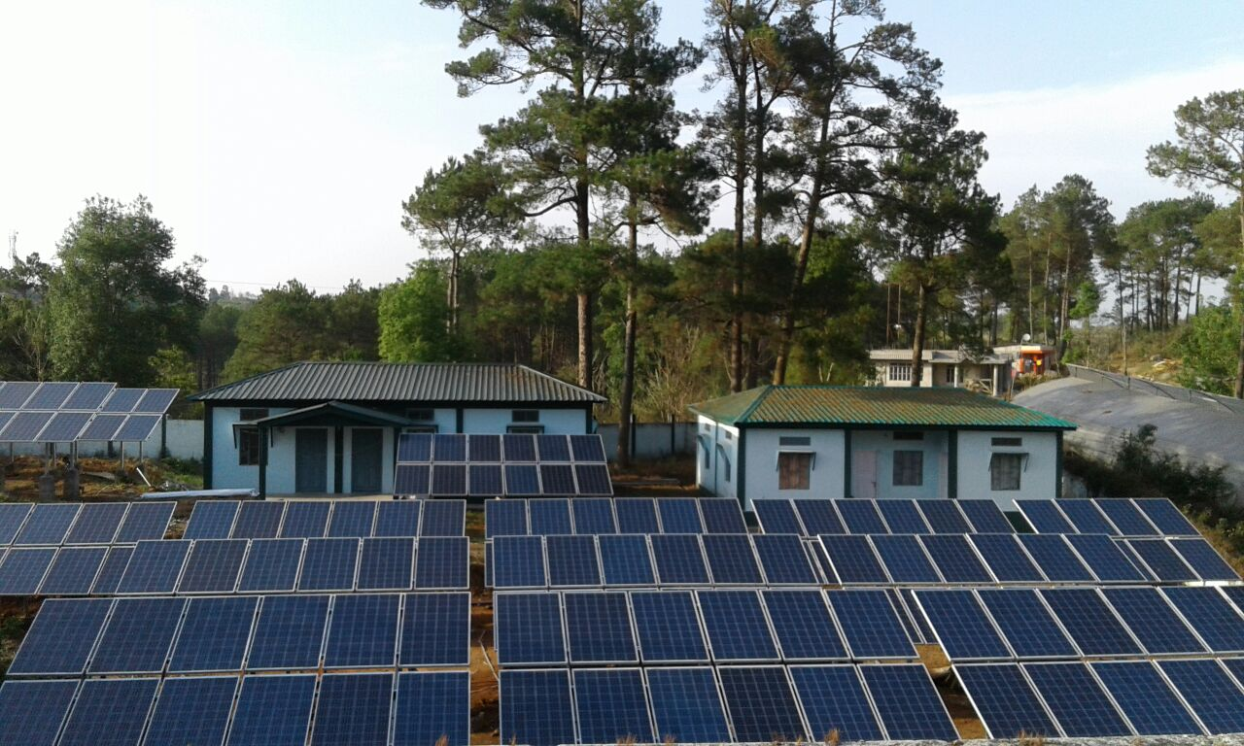
Two sub-categories:
Best
District Hospital category.
Onsite renewal energy generation
Healthcare facilities shall develop a plan for the use of alternative sources of energy.
Use PV solar panels on the roof for onsite renewable energy generation.
Installing PV solar panels reduces electricity consumption and helps to decrease the peak demand of a facility, which means the organization has lower operating costs, and hence these saved costs can be utilized for better patient care.
PAGE 41
PAGE 42

Slide 19

Two sub-categories:
Best
in the District Hospital category.
H1 Continuing…
H1.8
H1.6
Water appliances in the facility are energy efficient
No energy consuming equipment are switched-on when not in use
H1.9
The facility has taken adequate steps to reduce water heating expenses
H1.7
Lighting and electrical appliances in the facility are energy efficient
H1.10
PAGE 43
The Health Facility has adopted the "Passive architecture planning"
PAGE 44

Slide 20
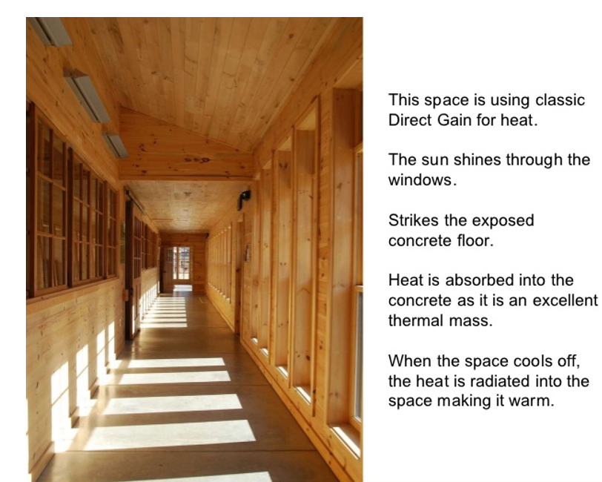
Two sub-categories:
Best
District Hospital category.
Implementation strategy
Passive architectural planning
Healthcare facilities Adopt passive architectural design features to minimize negative environmental impacts.
Climate-responsive concepts and design features (Eg: orientation, skylights, light wells, courtyard, shaded corridors, shading devices, shading from trees & adjacent buildings, pergolas, punched windows, extended louvers, horizontal and vertical landscaping).
Exterior openings
PAGE 45
PAGE 46

Slide 21
Two sub-categories:
Best
.
H2-Air and Noise Pollution
H2.3
H2.1
Availability of local hooding with exhaust for bathrooms and kitchen.
There is a public display system of scrolling of AQI in the facility
H2.4
Utilization of air purifiers to remove particulate matter from the indoor environment
H2.2
There is public display system of scrolling of AQI in the critical care units ICU, OT, SNCU etc.
H2.5
PAGE 47
Natural Ventilation is being maintained at the hospital premises
PAGE 48

Slide 22
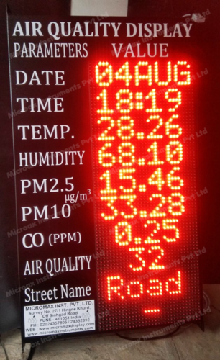
Two sub-categories:
Best
n all States/UTs, the top ranked DH will get best ‘eco-friendly’ award in the District Hospital category.
Best ‘eco-friendly’ CHC/SDH Award: - In all States/UTs, the top ranked CHC/SDH will receive an ‘eco-friendly’ award in CHC/SDH categorent.
Implementation strategy
Scrolling of AQI
Reduce air quality problems resulting from construction activities, and promote comfort and well-being of construction workers and building occupants.
Develop and implement an Indoor Air Quality (IAQ) management plan during construction and pre-occupancy phase, addressing the following measures, as applicable
PAGE 49
PAGE 50

Slide 23
AQI Basics for Ozone and Particle Pollution
Daily AQI Color | Levels of Concern | Values of Index | Description of Air Quality
Green | Good | 0 to 50 | Air quality is satisfactory, and air pollution poses little or no risk.
Yellow | Moderate | 51 to 100 | Air quality is acceptable. However, there may be a risk for some people, particularly those who are unusually sensitive to air pollution.
Orange | Unhealthy for Sensitive Groups | 101 to 150 | Members of sensitive groups may experience health effects. The general public is less likely to be affected.
Red | Unhealthy | 151 to 200 | Some members of the general public may experience health effects; members of sensitive groups may experience more serious health effects.
Purple | Very Unhealthy | 201 to 300 | Health alert: The risk of health effects is increased for everyone.
Maroon | Hazardous | 301 and higher | Health warning of emergency conditions: everyone is more likely to be affected.

Slide 24
Two sub-categories:
Best
.
H2 in continuation……
H2.8
H2.6
The facility is declared silent zone
No smoking policy is strictly adhered in the facility/COTPA Act 2003
H2.9
H2.7
Facility has taken measures to reduce noise pollution
H2.10
No garbage or biomass burning within the facility premises
PAGE 52
Availability of noise and emissions controlled DG Sets
PAGE 53

Slide 25
Two sub-categories:
Best
.
H3-Re-use, reduce & recycle the waste
H3.3
H3.1
Usage of washable surgical and nursing clothing after proper sterilization
Availability of waste management
policy that seeks to reduce, reuse and recycle waste
H3.4
H3.1
H3.1
H3.2
Practice of usage of reusable gloves and masks
Hospital procure the materials that generates less waste and are recyclable
H3.5
PAGE 54
Reduction of kitchen waste
PAGE 55

Slide 26
Two sub-categories:
Best
y.
H3…..
H3.8
H3.6
Facility is using biodegradable, compostable, or recyclable products in food services
Reduction of paper waste
H3.9
H3.7
H3.1
H3.1
Recycle of waste water from treatment plant
Facility is maintaining paperless office system
H3.10
PAGE 56
The Health Facility has a procedure to dispose waste to authorized agencies for Recycle
PAGE 57

Slide 27


Two sub-categories:
Best
.
H4-Save earth & environment
H4.4
H4.1
The facility is using eco-friendly bags and containers to store and transport the materials
Facility celebrated the Earth Day and World Environment Day to raise awareness
H4.5
H4.2
H3.1
H3.1
The facility is using eco- friendly stationaries items
No use of single use plastic bags in the facility
H4.3
No use of bottled water in the facility
PAGE 58
PAGE 59

Slide 28

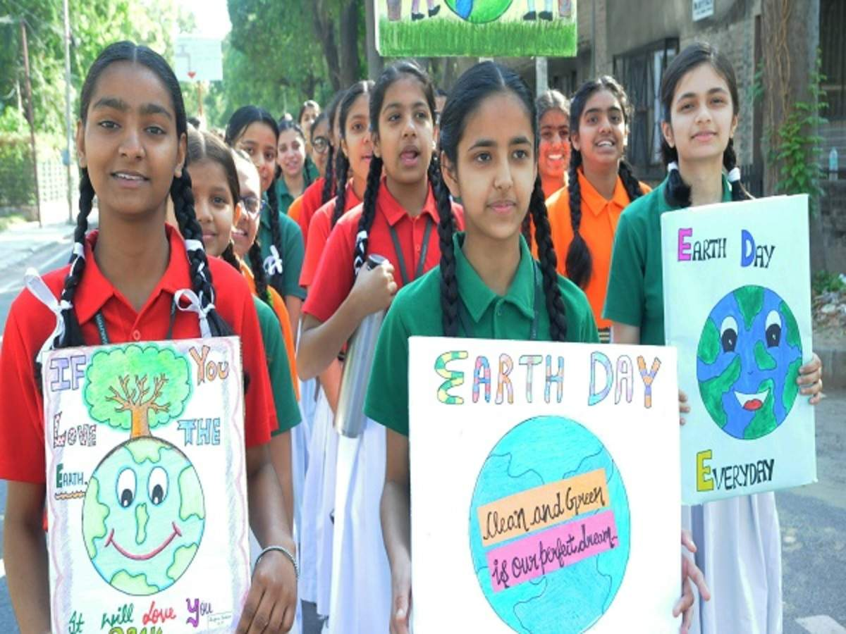
Two sub-categories:
Best
category.
Celebration of Earth Day(22nd April-Indoor)
Community awareness
PAGE 60
PAGE 61

Slide 29
Two sub-categories:
Best
category.
H4……
H4.6
H4.8
The facility is procuring locally made food items
The facility is using Eco friendly Refrigerants
H4.9
H4.7
H3.1
H3.1
The facility is using virtual platform for capacity building trainings
The facility is using Eco friendly Fire Suppression Systems
H4.10
PAGE 62
The facility is managing e-waste properly
PAGE 63

Slide 30
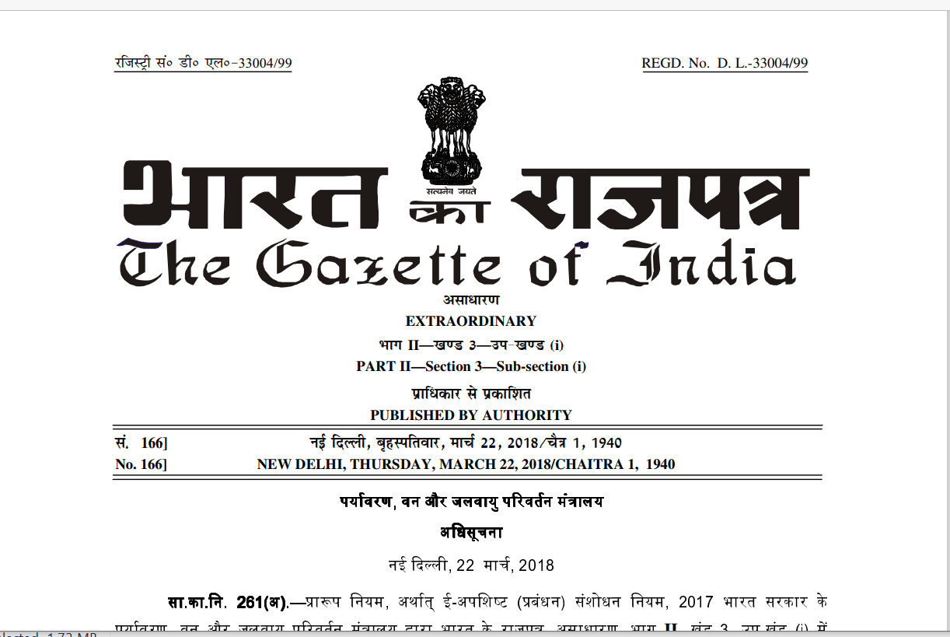
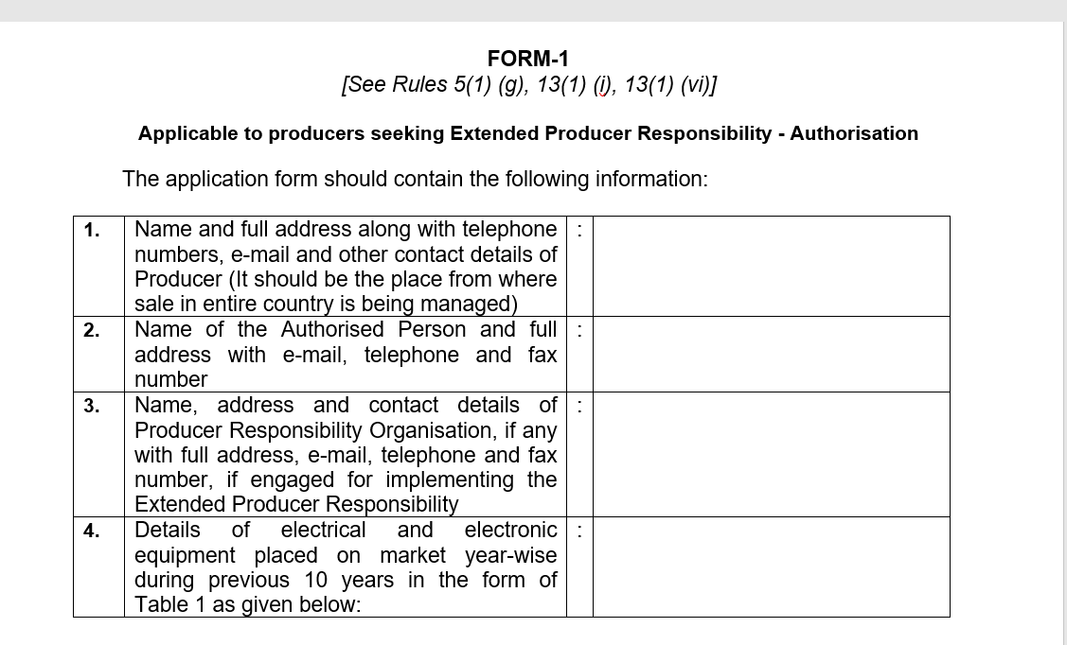
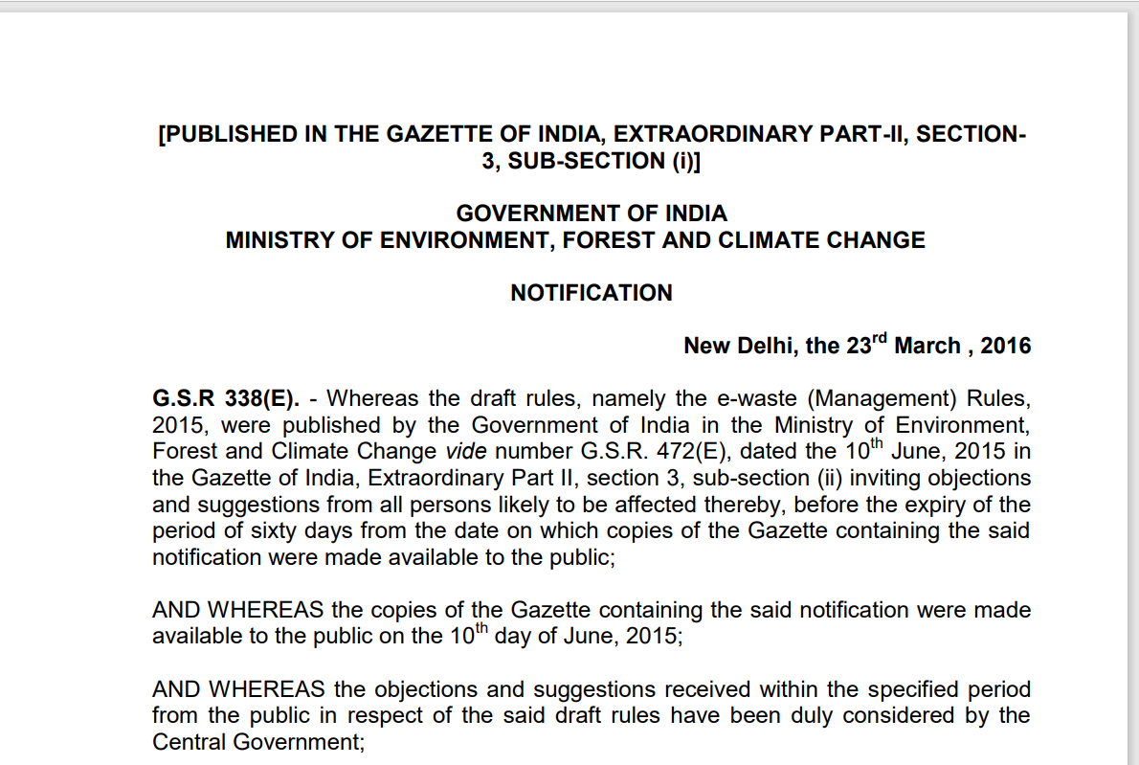
Two sub-categories:
Best ‘eco-friendly’ District Hospital: - In all States/UTs, the top ranked DH will get best ‘eco-friendly’ award in the District Hospital category.
Best ‘eco-friendly’ CHC/SDH Award: - In all States/UTs, the top ranked CHC/SDH will receive an ‘eco-friendly’ award in CHC/SDH category.
.
E waste Management
As we are moving towards digitalization, there will be an exponential increase in e waste.
50 millions tones of e waste were generated globally in 2018(only 20% was recycled)
India ranks 177 out of 180 countries in 2018 & 168 in 2020 : Environmental Preference Index published by World Economic Forum
PAGE 64
PAGE 65

Slide 31
Two sub-categories:
Best ‘eco-friendly’ District Hospital: - In all States/UTs, the top ranked DH will get best ‘eco-friendly’ award in the District Hospital category.
Best ‘eco-friendly’ CHC/SDH Award: - In all States/UTs, the top ranked CHC/SDH will receive an ‘eco-friendly’ award in CHC/SDH category.
H5-Health & Wellbeing
H5.3
H5.1
The Health Facility has indoor plants, those are having oxygen emitting quality
Facility design allows connecting to the nature
H5.4
H5.2
Disable friendly toilets are present inside the premises of the hospital and are functional
Green open spaces are maintained in the facility
H5.5
PAGE 64
Facility is accessible to differently abled and senior citizens
PAGE 65

Slide 32

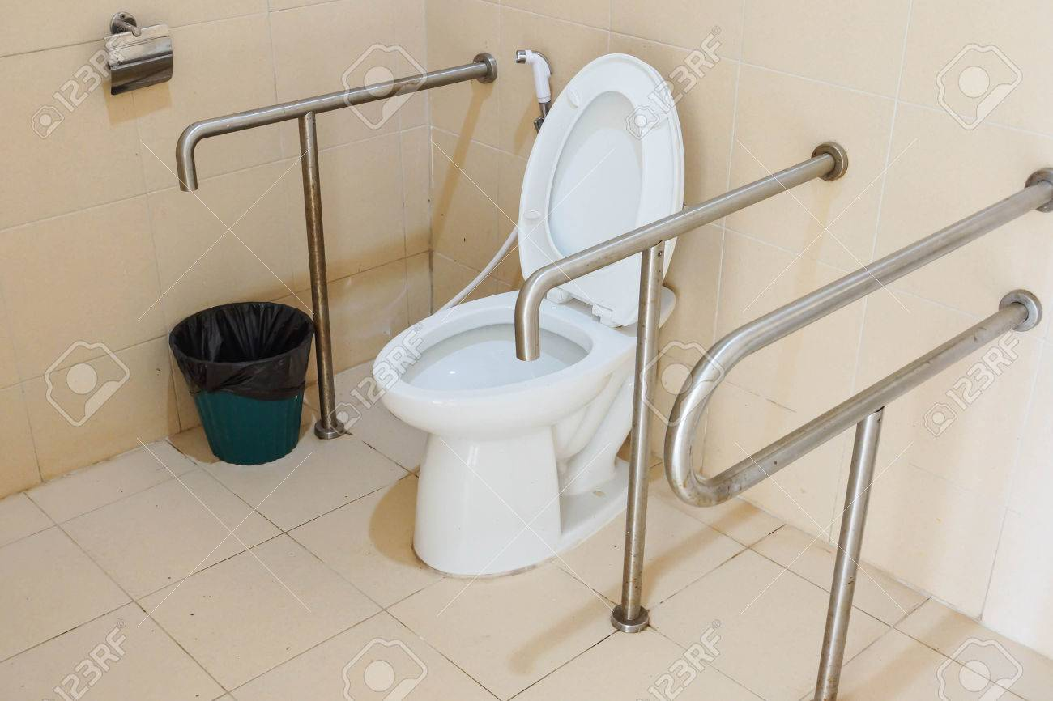
Two sub-categories:
Best ‘eco-friendly’ District Hospital: - In all States/UTs, the top ranked DH will get best ‘eco-friendly’ award in the District Hospital category.
Best ‘eco-friendly’ CHC/SDH Award: - In all States/UTs, the top ranked CHC/SDH will receive an ‘eco-friendly’ award in CHC/SDH category.
.
Implementation strategy
Indoor plants
Disability friendly toilets
PAGE 66
PAGE 67

Slide 33
Two sub-categories:
Best ‘eco-friendly’ District Hospital: - In all States/UTs, the top ranked DH will get best ‘eco-friendly’ award in the District Hospital category.
Best ‘eco-friendly’ CHC/SDH Award: - In all States/UTs, the top ranked CHC/SDH will receive an ‘eco-friendly’ award in CHC/SDH category.
.
H5…
H5.8
H5.6
Dedicated play area inside the premises of the hospital
Availability of stress relieving spaces in the facility for the staff and visitors
H5.9
H5.7
Availability of creche facility in the hospital
Availability of indoor and outdoor games for physical activities
H5.10
PAGE 68
Availability of cafeteria for patients and visitors
PAGE 69

Slide 34
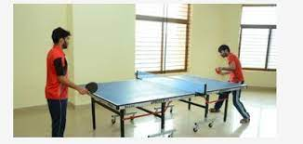
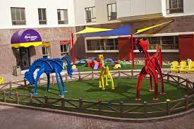
Two sub-categories:
Best ‘eco-friendly’ District Hospital: - In all States/UTs, the top ranked DH will get best ‘eco-friendly’ award in the District Hospital category.
Best ‘eco-friendly’ CHC/SDH Award: - In all States/UTs, the top ranked CHC/SDH will receive an ‘eco-friendly’ award in CHC/SDH category.
.
Implementation strategies
Indoor games
Dedicated play area(Paed.ward/NRC)
PAGE 70
PAGE 71

Slide 35
Two sub-categories:
Best ‘eco-friendly’ District Hospital: - In all States/UTs, the top ranked DH will get best ‘eco-friendly’ award in the District Hospital category.
Best ‘eco-friendly’ CHC/SDH Award: - In all States/UTs, the top ranked CHC/SDH will receive an ‘eco-friendly’ award in CHC/SDH category.
.
Generation of score card
01
03
Thematic are-H Score card
Eco-friendly score
02
04
Score card of all the thematic areas
Kayakalp score
PAGE 72
PAGE 73

Slide 36
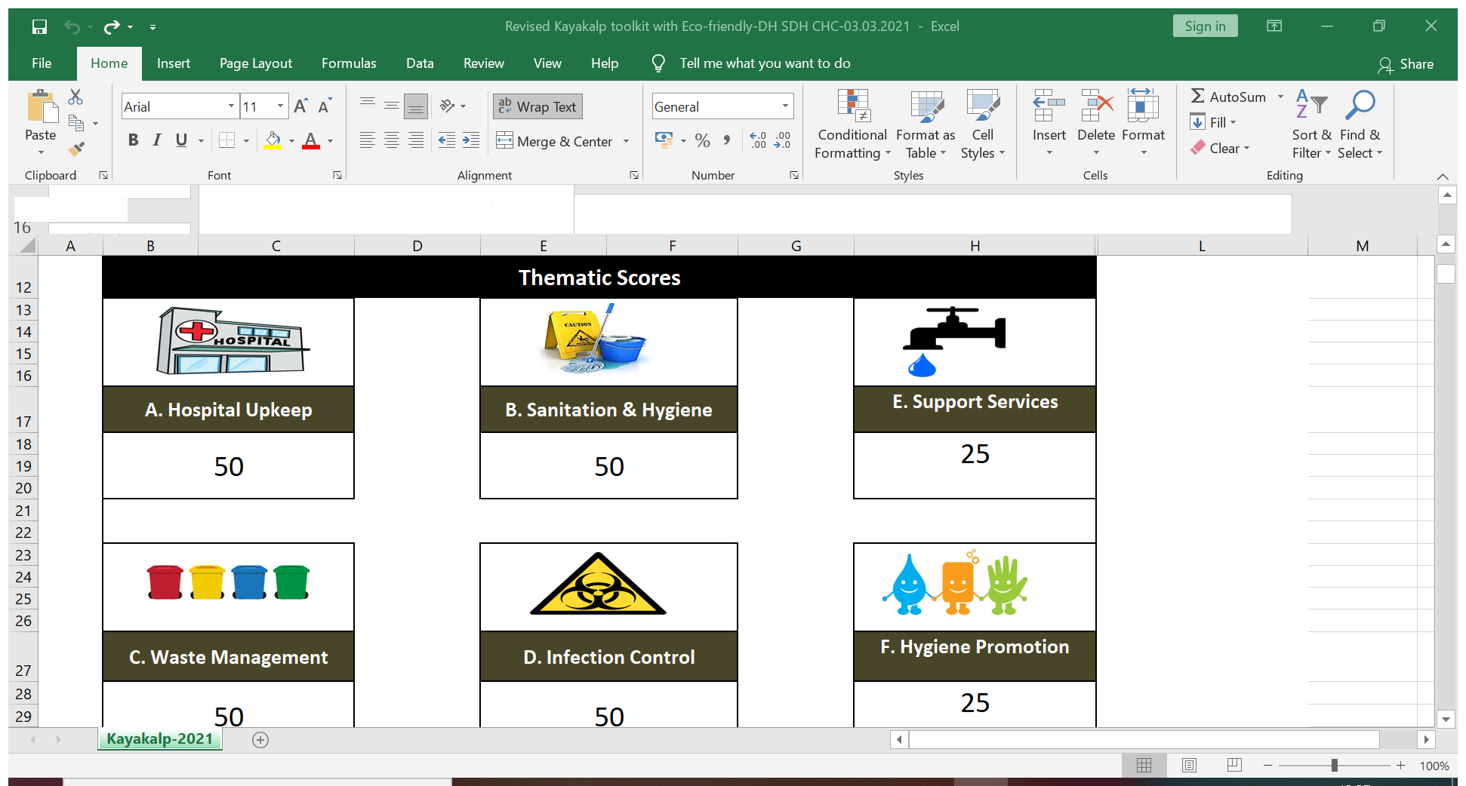
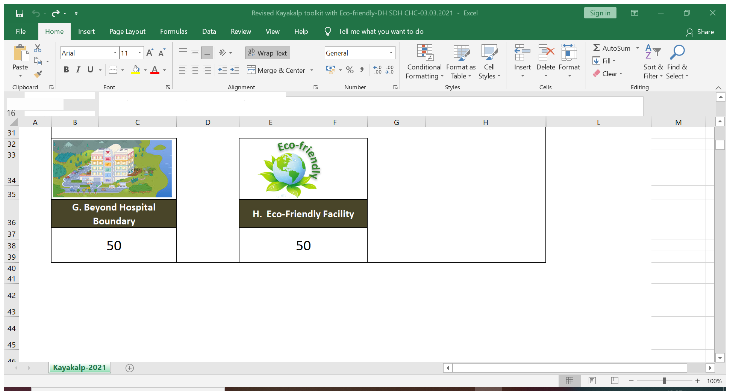
Two sub-categories:
Best ‘eco-friendly’ District Hospital: - In all States/UTs, the top ranked DH will get best ‘eco-friendly’ award in the District Hospital category.
Best ‘eco-friendly’ CHC/SDH Award: - In all States/UTs, the top ranked CHC/SDH will receive an ‘eco-friendly’ award in CHC/SDH category.
Thematic wise score card
H. Eco-friendly facility
H1 | Energy efficient facility | 20
H2 | Air and Noise pollution | 20
H3 | Reduce, re use and recycle the waste | 20
H4 | Save earth and environment | 20
H5 | Health and wellbeing | 20
PAGE 74
PAGE 75

Slide 37
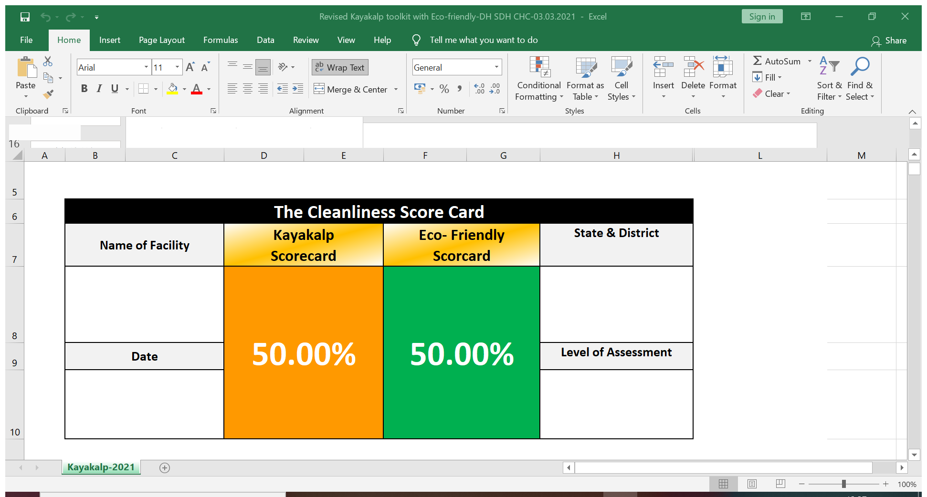
Two sub-categories:
Best ‘eco-friendly’ District Hospital: - In all States/UTs, the top ranked DH will get best ‘eco-friendly’ award in the District Hospital category.
Best ‘eco-friendly’ CHC/SDH Award: - In all States/UTs, the top ranked CHC/SDH will receive an ‘eco-friendly’ award in CHC/SDH category.
Kayakalp overall score card
PAGE 76
PAGE 77

Slide 38
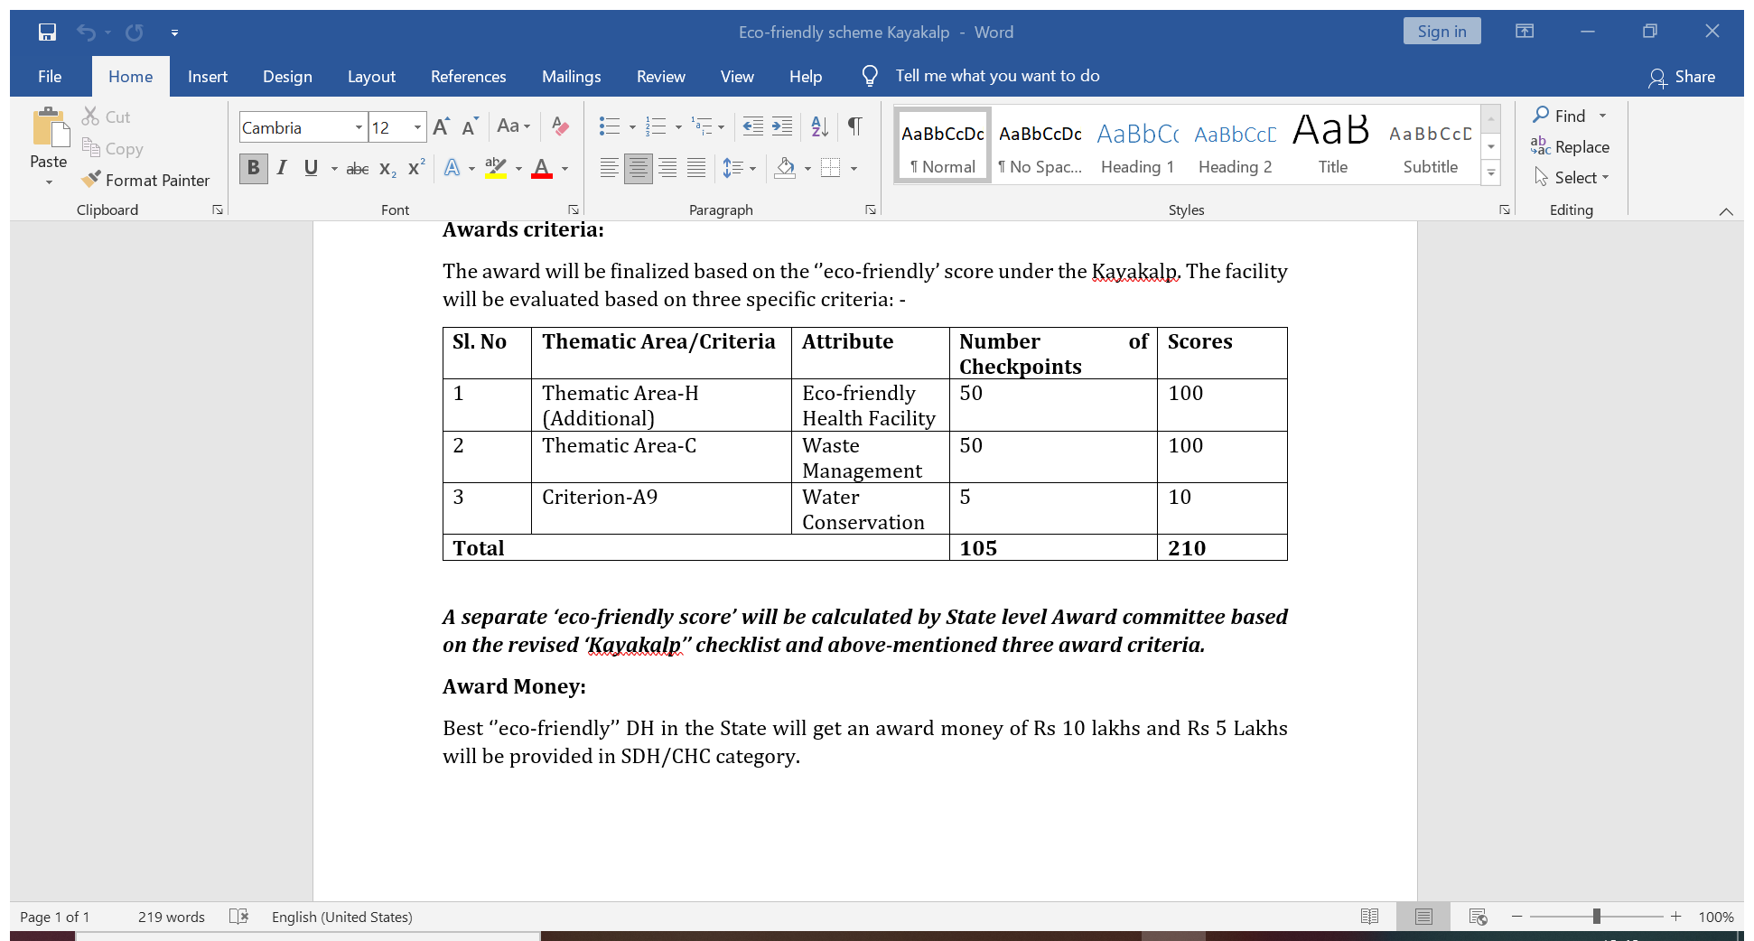
Two sub-categories:
Best ‘eco-friendly’ District Hospital: - In all States/UTs, the top ranked DH will get best ‘eco-friendly’ award in the District Hospital category.
Best ‘eco-friendly’ CHC/SDH Award: - In all States/UTs, the top ranked CHC/SDH will receive an ‘eco-friendly’ award in CHC/SDH category.
B. Eligibility criteria: at least 70% ‘’eco-friendly’’ score under the Kayakalp during external assessment.
Kayakalp overall score card
PAGE 78
PAGE 79

Slide 39
Two sub-categories:
Best ‘eco-friendly’ District Hospital: - In all States/UTs, the top ranked DH will get best ‘eco-friendly’ award in the District Hospital category.
Best ‘eco-friendly’ CHC/SDH Award: - In all States/UTs, the top ranked CHC/SDH will receive an ‘eco-friendly’ award in CHC/SDH category.
.
Eco-friendly Award scheme
Award criteria
Two sub-categories:
Best ‘eco-friendly’ District Hospital: - In all States/UTs, the top ranked DH will get best ‘eco-friendly’ award in the District Hospital category.
Best ‘eco-friendly’ SDH/CHC Award: - In all States/UTs, the top ranked SDH/CHC will receive an ‘eco-friendly’ award in SDH/CHC category.
B. Eligibility criteria: at least 70% ‘’eco-friendly’’ score under the Kayakalp during external assessment.
Sl. No | Thematic Area/Criteria | Attribute | Number of Checkpoints | Scores
1 | Thematic Area-H (Additional) | Eco-friendly Health Facility | 50 | 100
2 | Thematic Area-C | Waste Management | 50 | 100
3 | Criterion-A9 | Water Conservation | 5 | 10
Total |  |  | 105 | 210
PAGE 80
PAGE 81

Slide 40

Financial incentive
Points to think of
Introducing Go Green concepts in the healthcare facilities can help address National issues like
Infection
Epidemics
Handling of Bio-Medical waste
Water efficiency
Energy efficiency
Reduction in fossil fuel use for commuting
Consumer waste and in general conservation of natural resources
Most importantly, these concepts can enhance patients' health, recovery and well-being
Best ‘’eco-friendly’’ DH in the State will get an award money of Rs 10 lakhs and Rs 5 Lakhs will be provided in SDH/CHC category.
Over and above existing Kayakalp award money
PAGE 82
PAGE 83

Slide 41
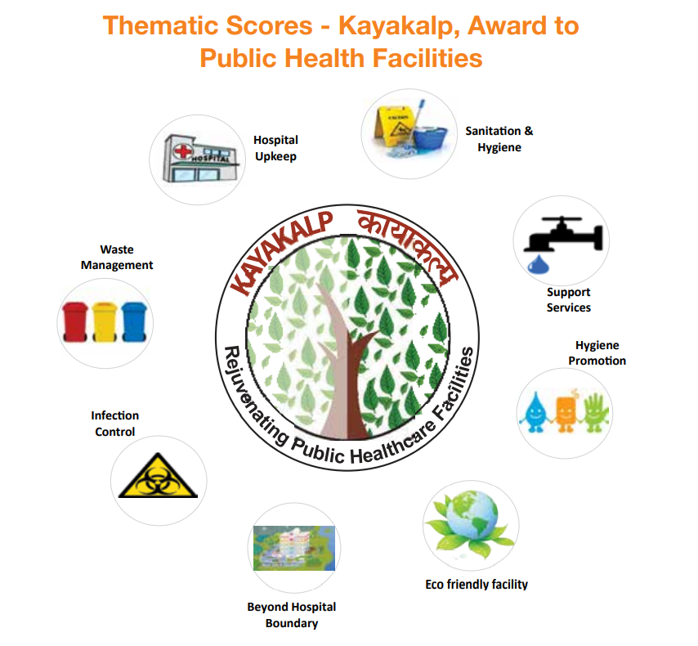
THANK YOU

